Slide 1
The Iterator Pattern
BIM460 Software Modeling
Fevzi APAYDIN

Slide 2
Iterator Pattern - Objective
Provide a way to access the elements of an aggregate object sequentially without exposing its underlying representation.
An aggregate object is an object that contains other objects for the purpose of grouping those objects as a unit. It is also called a container or a collection. Examples are a linked list and a hash table.

Slide 3
Motivation
An aggregate object such as a list should allow a way to traverse its elements without exposing its internal structure.
It should allow different traversal methods.
It should allow multiple traversals to be in progress concurrently.
But, we really do not want to add all these methods to the interface for the aggregate.

Slide 4
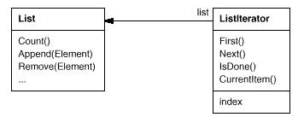
Iterator Example 1
List aggregate with iterator

Slide 5
Typical Client Code for ListIterator
...
List list = new List();
...
ListIterator iterator = new ListIterator(list);
iterator.First();
while (!iterator.IsDone()) {
Object item = iterator.CurrentItem();
// Code here to process item.
iterator.Next();
}
...

Slide 6
Applicability
Use the Iterator Pattern;
To support traversals of aggregate objects without exposing their internal representation.
To support multiple, concurrent traversals of aggregate objects.
To provide a uniform interface for traversing different aggregate structures.

Slide 7
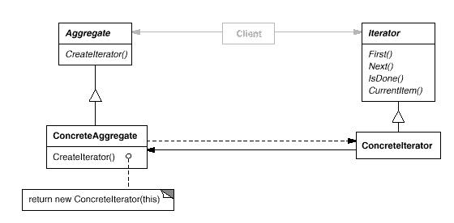
Structure

Slide 8
Participants
Iterator: Defines an interface for accessing and traversing elements.
ConcreteIterator:
Implements the Iterator interface.
Keeps track of the current position in the traversal.
Aggregate: Defines an interface for creating an Iterator object (a factory method!).
ConcreteAggregate: Implements the Iterator creation interface to return an instance of the proper ConcreteIterator.

Slide 9
Java Implementation Of Iterator
We could implement the Iterator pattern “from scratch” in Java.
But, as was the case with the Observer pattern, Java provides built-in support for the Iterator pattern.
The java.util.Enumeration interface acts as the Iterator interface.
Aggregate classes that want to support iteration provide methods that return a reference to an Enumeration object.
Java JDK 1.1 has a limited number of aggregate classes: Vector and Hashtable.
Java JDK 1.2 introduced a new Collections package with more aggregate classes, including sets, lists, maps and an Iteratorinterface.

Slide 10
Demo

Slide 11
Thank You!
References:
The Design Patterns Java Companion, James W.Cooper
Design Patterns,
Elements of Reusable Object – Oriented Software Serena Fabbri
Head First Design Patterns, O’Reilly

